Slide 1

GenreBridge Overview
Christina Wofford
CSCI-765
05/08/2023

Slide 2

Introduction
GenreBridge is an application that seeks to provide users with an enhanced reading experience by providing them with an optimized soundtrack for their current piece of literature in order to maximize the benefits of both reading and listening to music.
“Research has shown that pairing books with music can increase immersion and create a deeper emotional connection with the material, ultimately improving the overall experience for readers” (Boltz, 2001)
"Engaging with popular culture can foster a sense of belonging, promote self-esteem, and offer possibilities for self-reflection and self-discovery" (Van den Bulck, Custers, & Nelissen, 2016, p. 1355)
By understanding the factors that contribute to a successful pairing, GenreBridge can offer more accurate and personalized suggestions and combine the best of two worlds by helping users find the soundtrack for their next read, something valuable to book lovers and music enthusiasts alike.
Notes:
GenreBridge is an application that seeks to provide users with an enhanced reading experience by providing them with an optimized soundtrack for their current piece of literature in order to maximize the benefits of both reading and listening to music.
"Research has shown that pairing books with music can increase immersion and create a deeper emotional connection with the material, ultimately improving the overall experience for readers.
Furthermore, engaging with popular culture can foster a sense of belonging, promote self-esteem, and offer possibilities for self-reflection and self-discovery.”
GenreBridge seeks to aid in this by allowing users to find Spotify playlists to pair with any chosen book, as well as by collecting additional data points from which it can derive trends between books and popular music so that users can keep up with popular culture while still indulging in what they love.
GenreBridge attempts to popular literature and music that is directly relevant to their interests, allowing them to partake in a solo hobby while also while also staying connected to connected to the predominate trends in current media.

Slide 3

Course Relevance
Built on a well-structured data model with tables, attributes, and relationships representing real-world entities
Uses SQL commands to create tables, specify data types, constraints, and primary/foreign keys
SQL employed for data manipulation: inserting, updating, deleting records
SQL queries for data aggregation, filtering, and analysis to discover trends and insights
Integration with Google Books and Spotify APIs for data retrieval and relationship establishment
Notes:
Built upon a well-structured data model with tables, attributes, and relationships representing real-world entities
SQL commands used for creating tables, specifying data types, constraints, and primary/foreign keys
Ensures data integrity and efficient data retrieval
SQL employed for data manipulation: inserting, updating, deleting records
Integration with Google Books and Spotify APIs for data retrieval and relationship establishment
SQL queries for data aggregation, filtering, and analysis to discover trends and insights

Slide 4

Implementation
Front End
HTML
CSS
JavaScript
BootStrap
Application Layer
Python
Flask
Back End
PostgreSQL
Notes:
GenreBridge is built using HTML, CSS, JavaScript, and Bootstrap for the frontend, and Python (including a large number of libraries) with Flask for the backend.
It queries the Google Books and Spotify APIs to retrieve relevant data and store it in a normalized PostgreSQL database.
It also uses matplotlib to analyze the collected data and visualize trends for better comprehension.
With the implementation detail accounted for, we can move onto results.

Slide 5
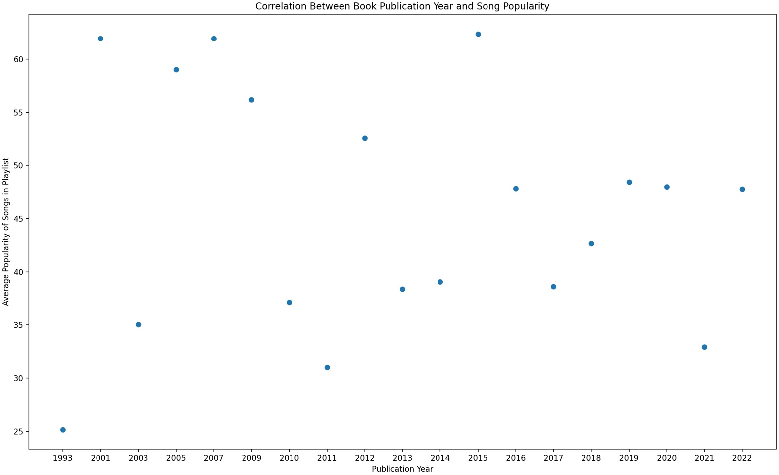
Book Publication Year vs. Average Song Popularity
Notes:
Reading a newly released book does not by default mean that a user will be exposed to the most popular music in their matched playlist.
In fact, no book in the dataset that was released within the past five years had greater than average popularity score of 50 based on Spotify’s algorithms.

Slide 6
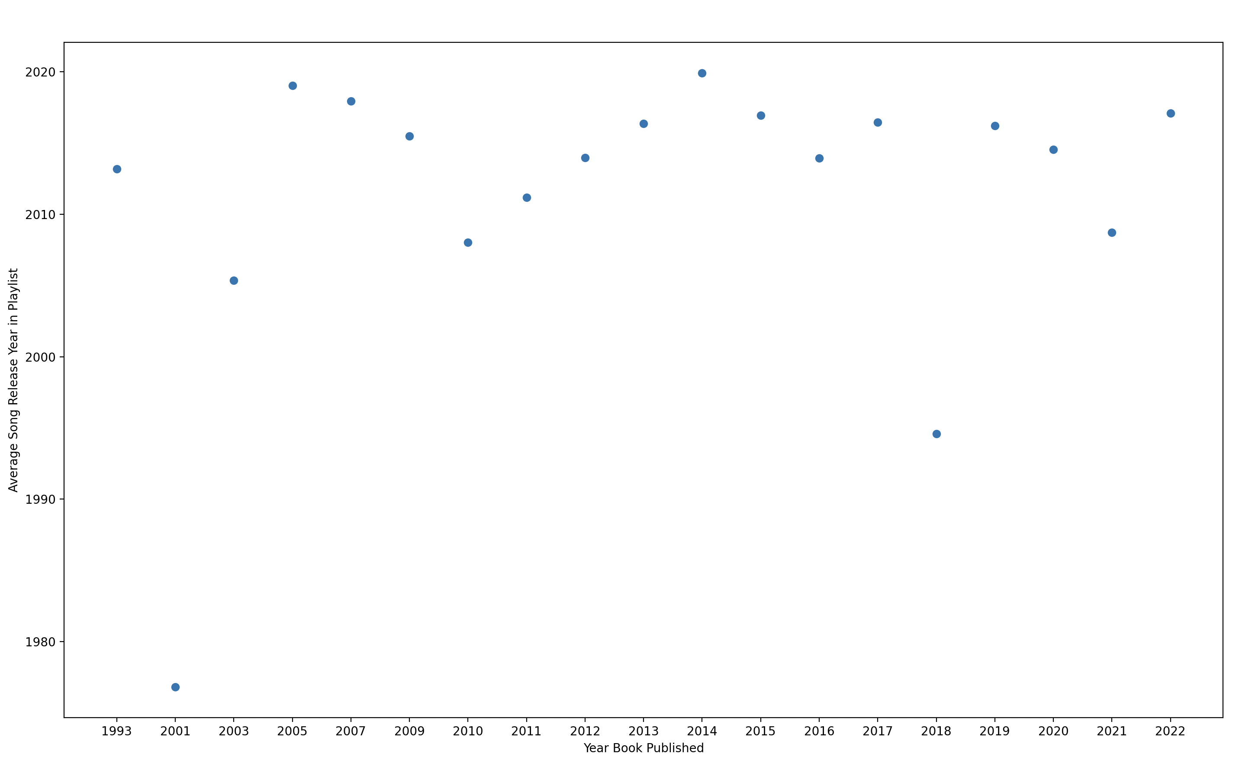
Book Publication Year vs Average Song Release Year
Notes:
There is a positive correlation between reading newly released books and being exposed to new music, even if it’s extremely popular.
This makes sense as older books are more likely to have older playlists that were constructed before the release of music that is currently popular.

Slide 7
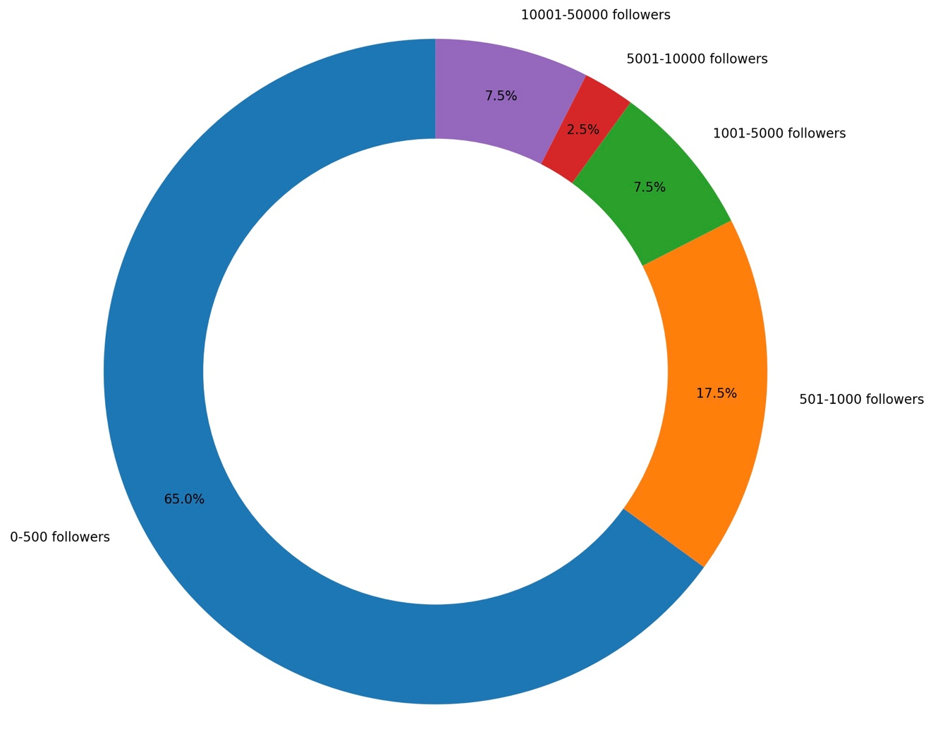
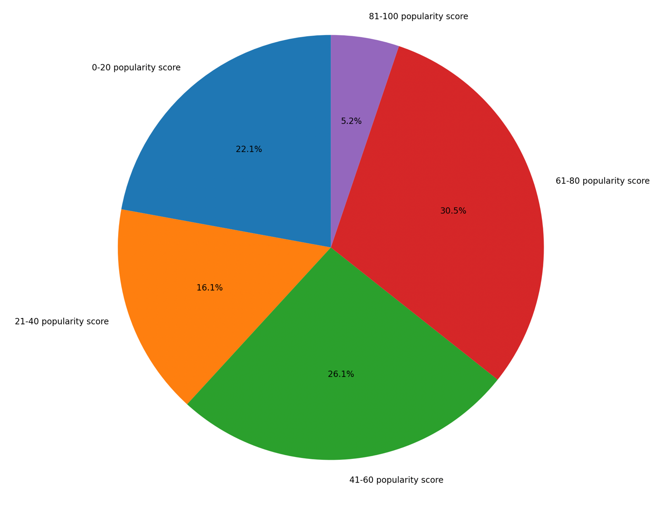
Distribution of Playlist Followers and Song Popularity
Notes:
Most playlists are niche with under 500 followers and a very small number of songs are extremely popular.
This means that users are still being presented with the chance to stumble across a hidden gem while being exposed to popular new music.
The number of songs that are extremely popular at any given point in time is incredibly low only about 5% of songs achieving a score over 80 per Spotify’s ranking based on their internal data.

Slide 8
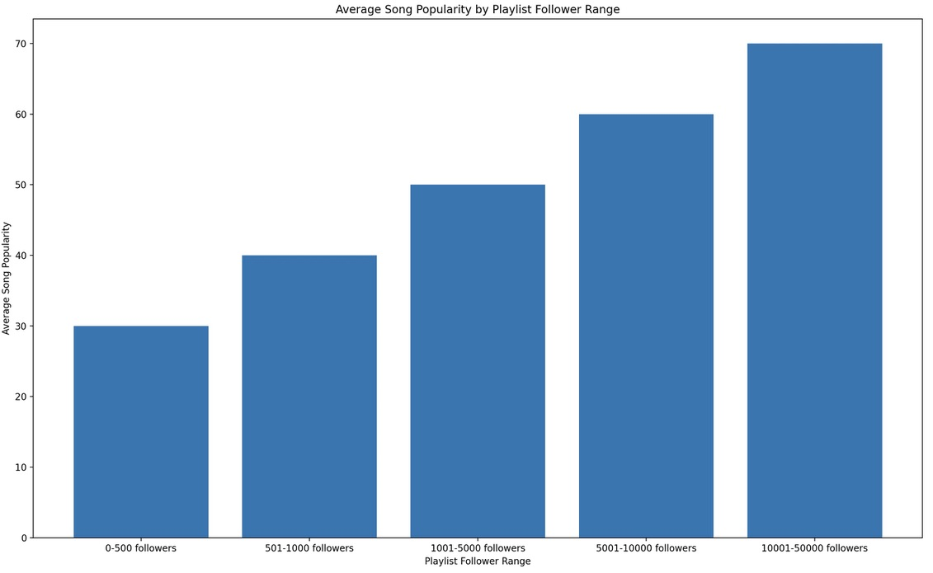
Number of Playlist Followers vs. Average Song Popularity
Notes:
Music that is not extremely popular is more likely to be niche genres, allowing for exposure to new things. With 65% of playlists having 0-500 followers the odds of a user being presented with one of these is high. This does not impede exposure to new, popular music.
Even though only 7.5% of playlists have over 10,000 followers, they are almost certain to introduce users to what is popular, particularly given that the number of incredibly popular songs at any given time is relatively small as is evidenced in Figure 9.

Slide 9
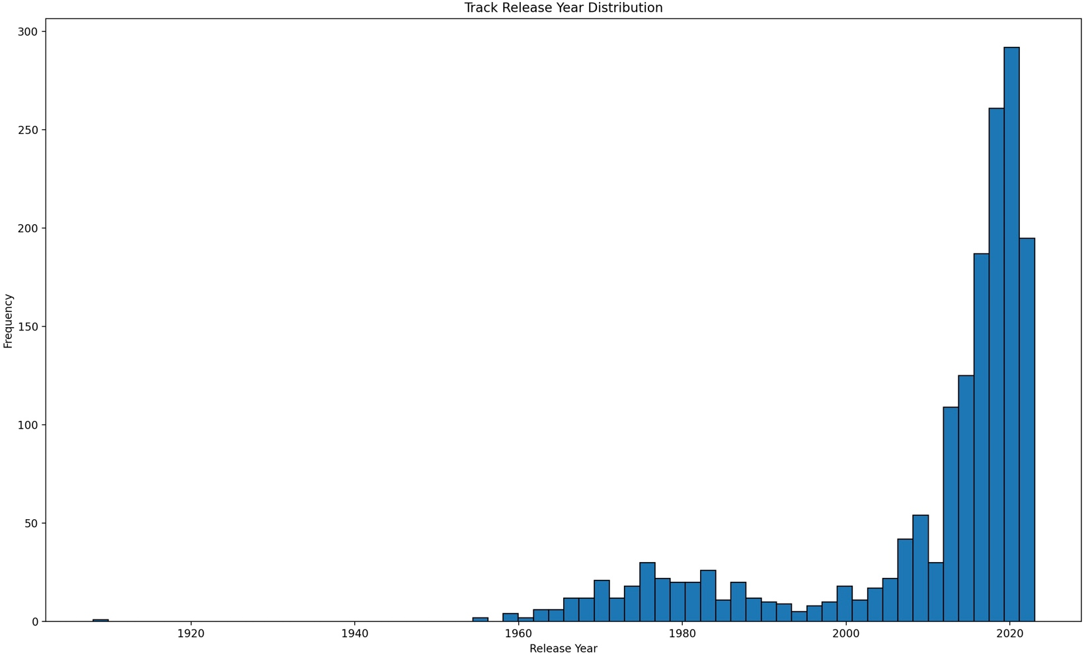
Track Release Year Distribution
Notes:
The overrepresentation of new music in playlists makes it very likely that a user will not only be exposed to new, popular music, but new music in general which again provides a growth opportunity, providing yet another benefit.

Slide 10
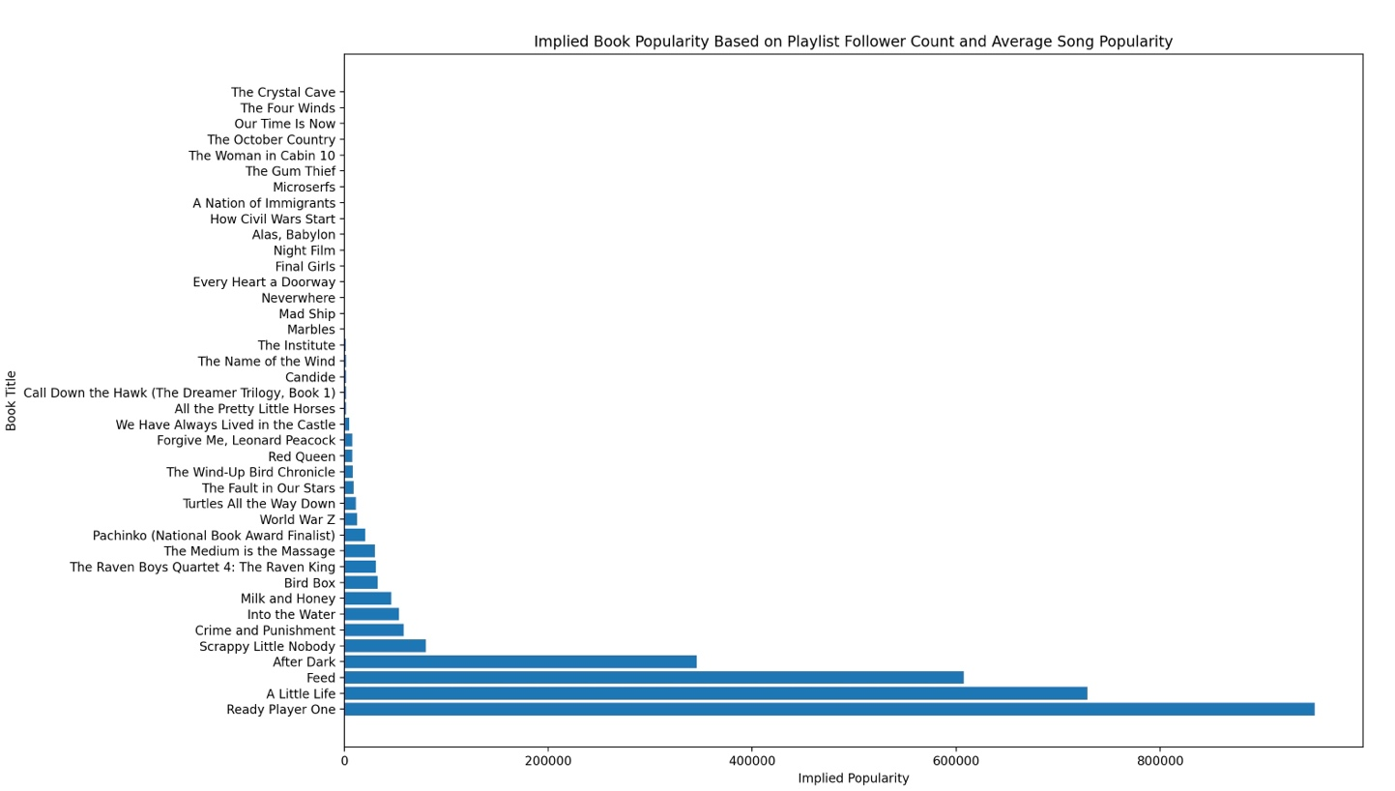
Implied Book Popularity
Notes:
There are benefits to stepping outside of one’s comfort zone and intentionally engaging with popular media.
Van den Bulck, Custers, & Nelissen - "Engaging with popular culture can foster a sense of belonging, promote self-esteem, and offer possibilities for self-reflection and self-discovery” and even the potential of unlocking these benefits makes it worth engaging with popular media, even if only from time to time.
It is easy enough to look a New York Times Bestsellers list or turn on the radio to determine the books and movies that are currently popular, but these sources only provide a one-dimensional view into the best media to engage with. As was previously mentioned, the benefits of reading are heightened by the experience of listening to music and vice versa.
In order for one to make the best use of their limited free time while still obtaining a high level of benefit, they must optimize their experience and GenreBridge aids in this endeavor.

Slide 11

Conclusions
GenreBridge can offer more accurate and personalized suggestions and combine the best of two worlds by helping users find the soundtrack for any book of their choosing
The granular data collected by GenreBridge also provides an excellent starting point for further exploration into the relationship between the popularity of books, playlists, and individual songs

Slide 12

References
Boltz, M. G. (2001). Musical soundtracks as a schematic influence on the cognitive processing of filmed events. Music Perception: An Interdisciplinary Journal, 18(4), 427-454. https://doi.org/10.1525/mp.2001.18.4.427
Chanda, M. L., & Levitin, D. J. (2013). The neurochemistry of music. Trends in Cognitive Sciences, 17(4), 179-193. https://doi.org/10.1016/j.tics.2013.02.007
Johansson, Roger, et al. “Eye Movements and Reading Comprehension While Listening to Preferred and Non-Preferred Study Music.” Psychology of Music, vol. 40, no. 3, 2011, pp. 339–356. https://doi.org/10.1177/0305735610387777.
Oatley, K., & Djikic, M. (2020). Reading and Life: Empathy, Knowledge, and the Retention of Plot. Review of General Psychology, 24(3), 285-296. https://doi.org/10.1177/1089268020919756
Van den Bulck, H., Custers, K., & Nelissen, S. (2016). The psychological benefits of superheros and other popular culture for fans of all ages. The Journal of Popular Culture, 49(6), 1349-1359. https://doi.org/10.1111/jpcu.12494

